Slide 1
“…if there are photos you are really concerned about ... Print them out.”
Dr Vinton “Vint” Cerf, vice-president of Google

Slide 2
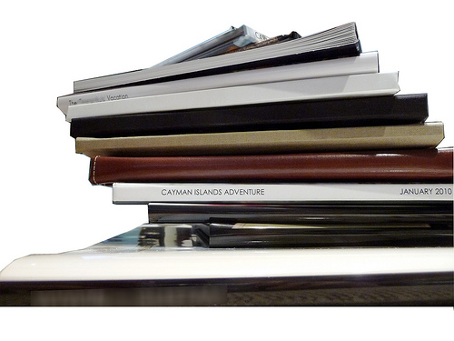
Why photobooks?
More compact than traditional albums
The story is on the page, not on the back of the photo
Photobook companies keep a copy of your book for many years
Great for sharing
Print many copies

Slide 3
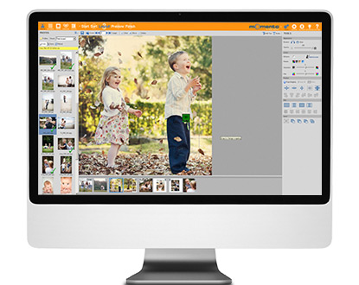
Method
At a photo kiosk in a shop eg Officeworks, BigW
On the internet – upload the photos eg Shutterfly
On your computer – download their free software eg Momento, Albumworks, PhotobookAus…

Slide 4
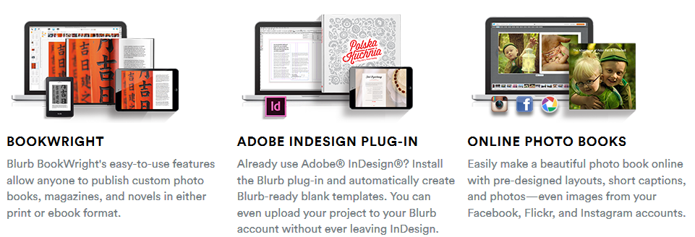
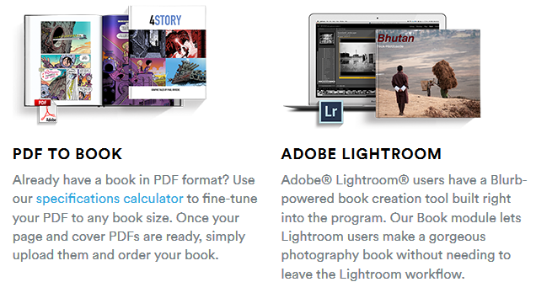
Blurb options!

Slide 5
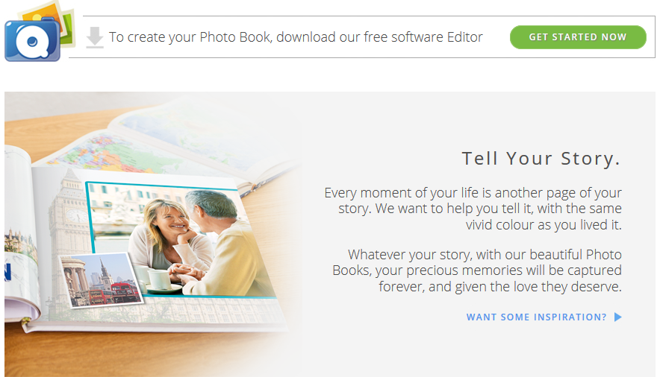
A demo
demo

Slide 6
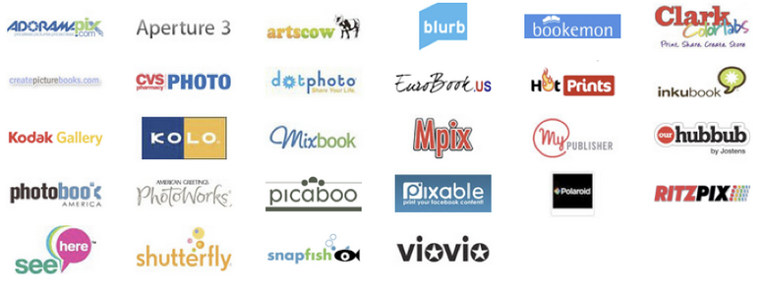
Which photobook?
Decide based on
Size
Cost
Quality of print and paper
Maximum number of pages
Ease of adding photos
Range of templates for page layout
Coupons and special deals
photobookgirl

Slide 7
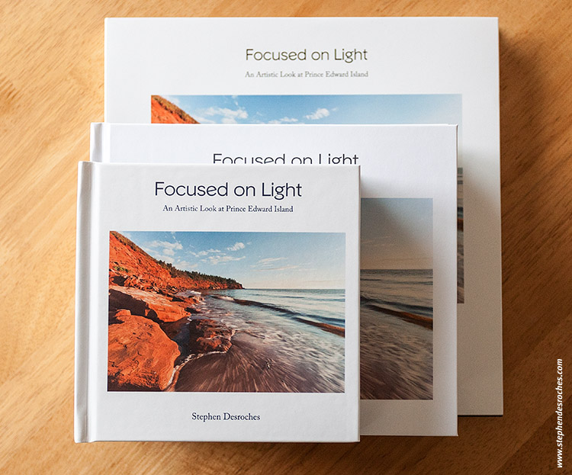
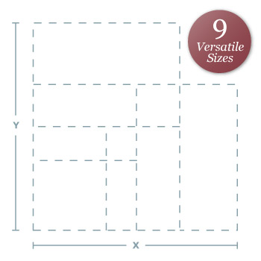
Photobook Sizes
Square
Landscape
Portrait
momento

Slide 8
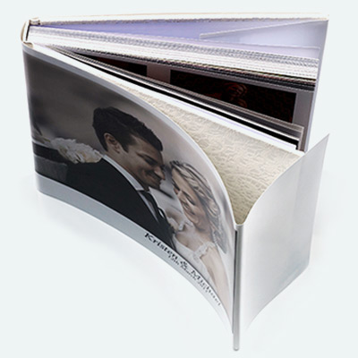
Cost
You get what you pay for!
An expensive album usually has
High quality paper
Vibrant colours, especially on the cover
Tight, long-lasting binding
momento
albumworks

Slide 9
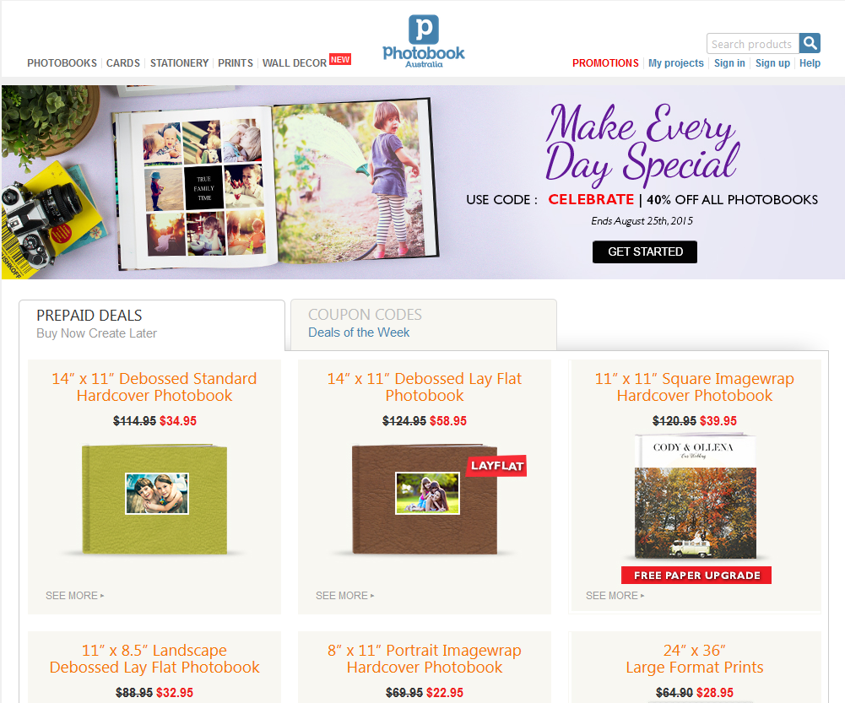
Check their site for deals

Slide 10
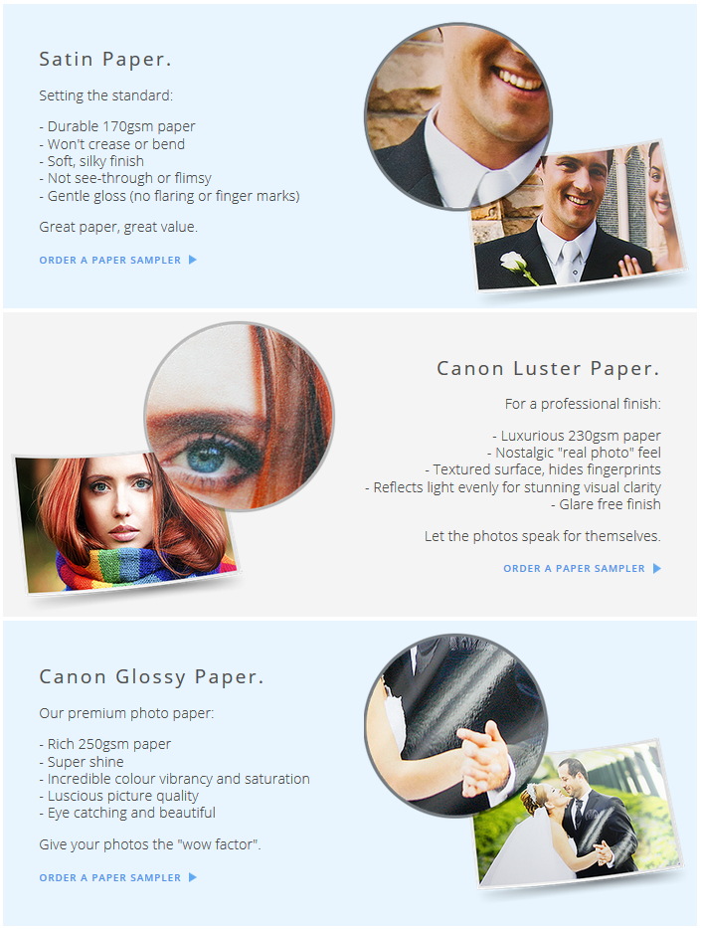
Papers
Satin
Glossy
Specialty papers
Luster
Layflat pages
… order a sample
albumworks

Slide 11
Choose your photos
Put all photos you’d like to use in one place
Check your photos have enough pixels (at least 150pixels per inch)
Edit photos for colour balance, red-eye, etc
If possible, name the photos in the order you want them in the book

Slide 12
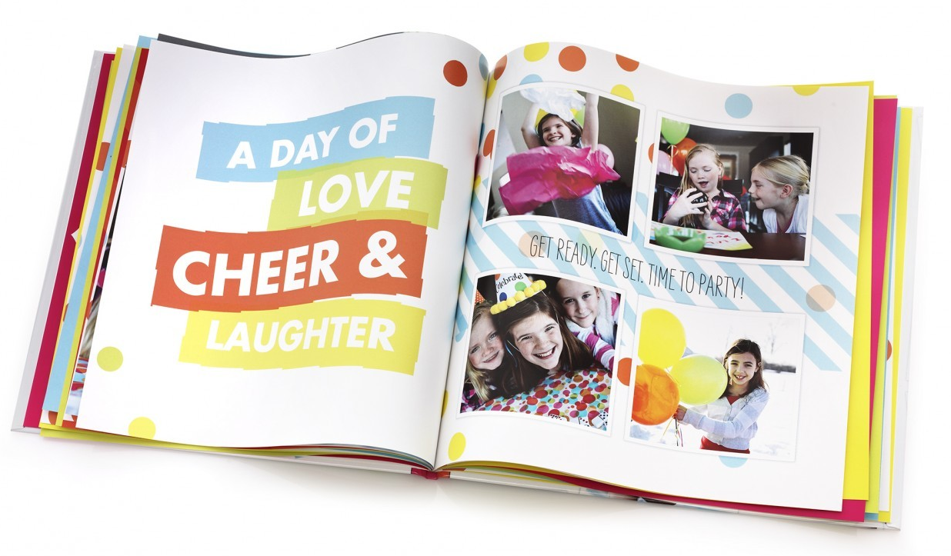
Download your software
Start a new book
Give it a name
Specify the size
shutterfly

Slide 13
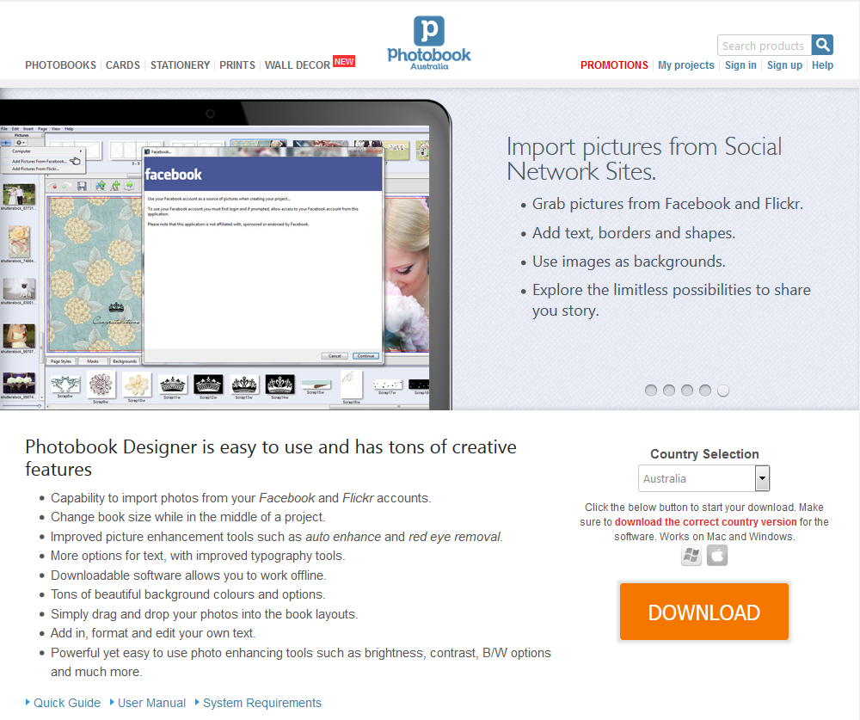
Download your software

Slide 14
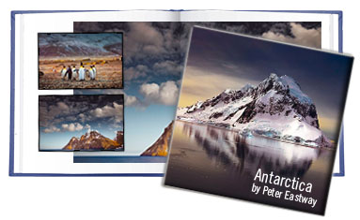
Design
“A well designed photobook will present the photographs beautifully without your viewers being confused or distracted by the design itself.”
momento

Slide 15
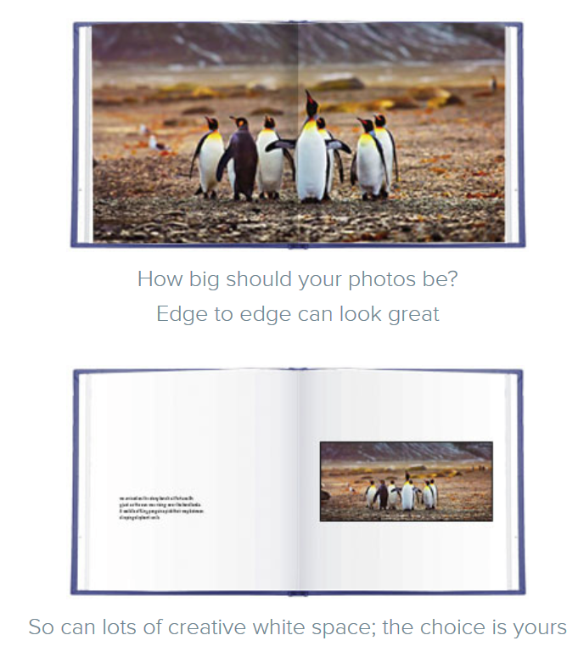
You can see a range of styles in the gallery
momento

Slide 16
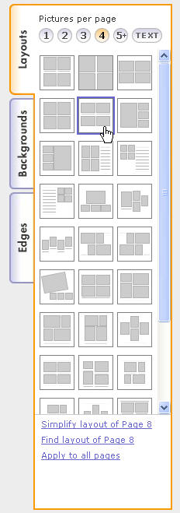
Set up your design
Theme – most are a bit tacky!
Background colour – black, white or dark gray are best
Set of templates – look for ones that work well together
Keep it simple so your photos shine
shutterfly

Slide 17
Insert your photos
Autoflow
Manual

Slide 18
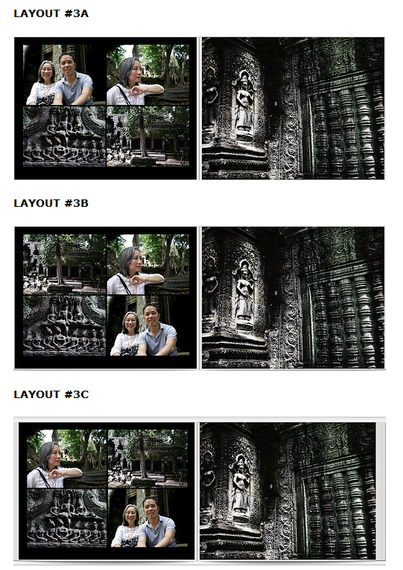
Photo placement
Balance the colors
People look into the page
Use a mirrored template on facing page OR full page photo

Slide 19
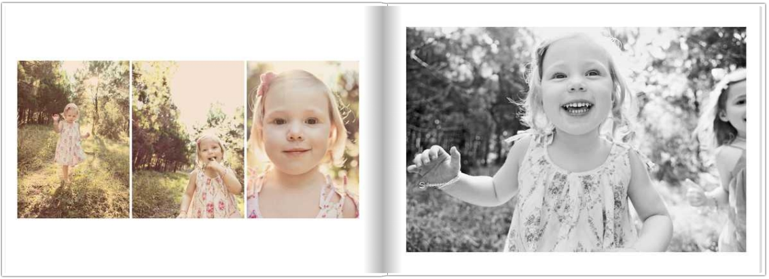
Edit photos
Lighten the photos
Turn some to black and white
Zoom in and crop
Watch out for the quality warning!

Slide 20
Add the text
Use one or two fonts
Your title font can match the theme of your book
Your caption/story font should be clean and easy to read
If adding a story, type it in Word and spell check, then paste into your book.

Slide 21
General design rules
Consistency – this applies to fonts, frames, effects, colors, type size
Alignment – of photos and text
Margins – the edges may be cropped
Gutter – “mind the gap” in the centre
White space – is good!
Contrast

Slide 22
Before uploading
Check
Spelling
nothing in the bleed zone
photos line up and in the right order
etc
Check again
Triple check
…you will STILL find errors once it arrives!

Slide 23
Helpful sites
http://www.photobookgirl.com

